Slide 1
Victoria Real Estate Update
July 18, 2022
Talking Interest Rates with Mortgage Broker
Jen Lowe

Slide 2
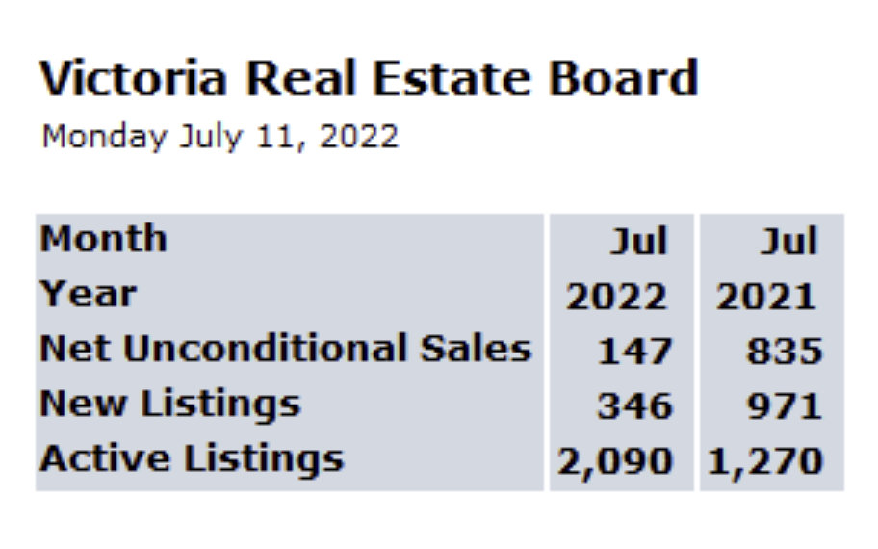
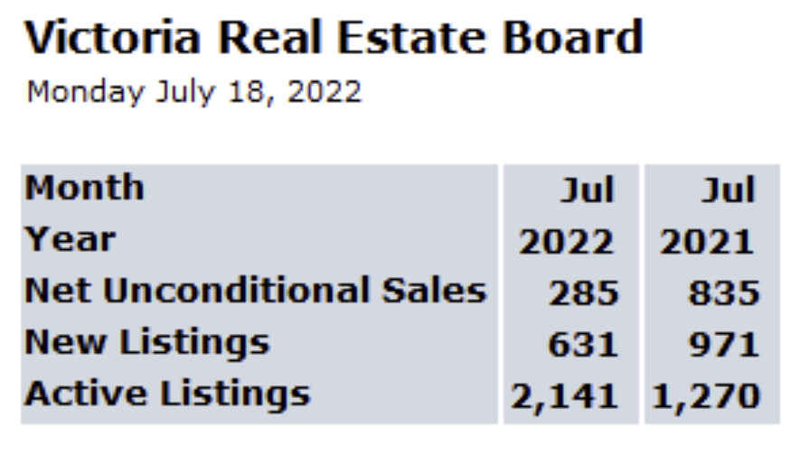
Week to Week Comparison
June 11, 2022
July 18, 2022

Slide 3
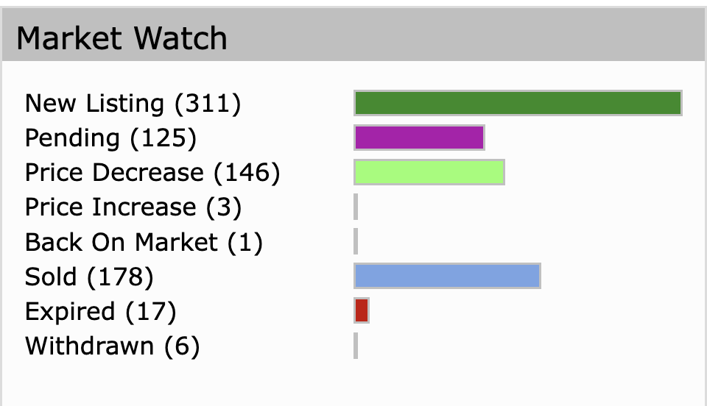
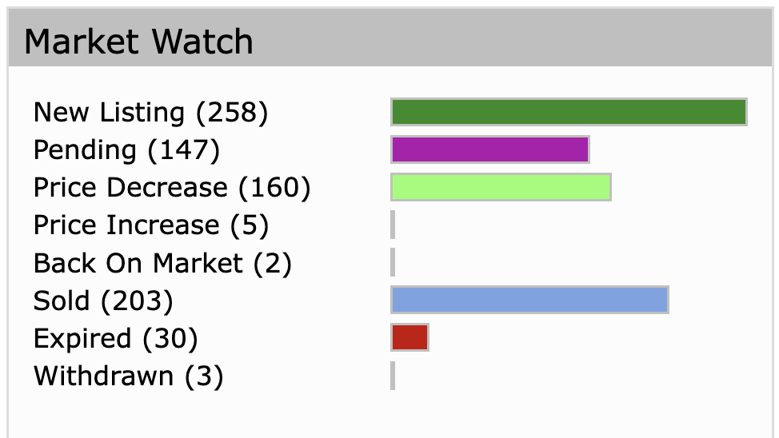
Week to Week Comparison
July 11 2022
July 18, 2022

Slide 5
Bank of Canada raised its overnight /prime lending rate from 1.5% to 2.5%
Domestic cost of living up to do…
Supply Chain, War in Ukraine,
More than half the components that make up the CPI are now rising by more than 5%
Wage inflation accelerated to 5.2%
Unemployment is down to 4.9%
Job Vacancy Rates are high
Canadian businesses are raising prices
The bank expects global economic growth to slow to 3.5% and 2% in 2023 before strengthening in 2024 to 3%
Economic Growth is expected to weaken next year.
So, expect year end rate to grow to 3.5%

Slide 6
Victoria Real Estate Show – Mondays 10 AM

